Slide 1

Capstone Project Phase 2 - 23-2-D-7
Camera measurement of physiological vital signs monitoring system
Supervisors: Dr. Dan Lemberg and Mrs. Elena Kramer
Students: Shimon Rubin and Lior Guzovsky

Slide 2
Table of content
Background
Tools & Algorithms
Requirements
Challenges
Solution
Results
Testing Process
Project Metrices
Conclusion & Insights
Project Demo

Slide 3
Background
Personal story as an inspiration
Traditional monitoring heart rate methods VS. Contactless monitoring
Desired outcome
System’s necessity
Notes:
1. From a personal story of a family member who was in a nursing home, we have noticed that the therapist-patient ratio during the night shifts is relatively small and therefore dangerous for the patients
2. Traditional methods use contact-based devices like pulse oximeters for vital sign measurement. However, these methods can be intrusive and uncomfortable, especially for elderly individuals in nursing homes, In addition, the traditional methods demand more therapists which is a problem we won’t be able to solve.
2. Monitoring heart rate from video data has become a popular research area for non-contact vital sign measurement
3. Our desired outcome is a real time monitoring Application
4. Accurate and timely monitoring of heart rate is vital in the medical field for diagnosing and managing cardiovascular conditions

Slide 4
Tools & Algorithms
Hemoglobin – Pulse Relations
Pulse Oximeter
Haar Cascade classifier
Fast Fourier Transform
Different filter combinations (High \ Low pass filter)
PyQt5 UI Designer

Slide 5
Main system requirements
The system shall process video from a camera or recorded video files
The system shall accurately detect and track the subject's face
The system shall evaluate the pulse signals and extract the heart rate
The system shall provide real-time heart rate measurements
The system shall apply pre-processing techniques to reduce noise

Slide 6
Challenges

Slide 7
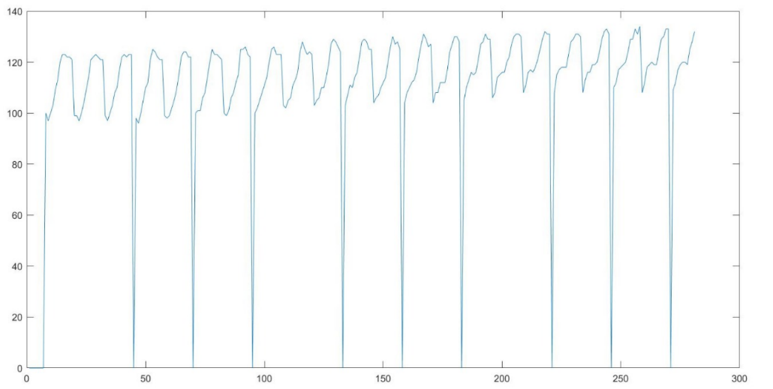
Challenges
Data set creation
Unfamiliar field – image processing
Raw data size
Noise filtering
Updated pipeline

Slide 8
Solution

Slide 9
Pipeline
Input video
Locate Eyes
Locate ROI

Slide 10
Pipeline
Color space
Frequency domain space
Absolute FFT values

Slide 11
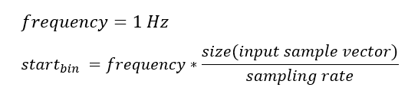
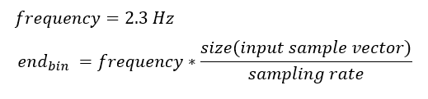
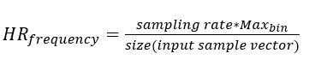
Pipeline
Calculate HR low & high threshold
Search highest value
Calculate frequency
Calculate Heart Rate

Slide 12
Results

Slide 13
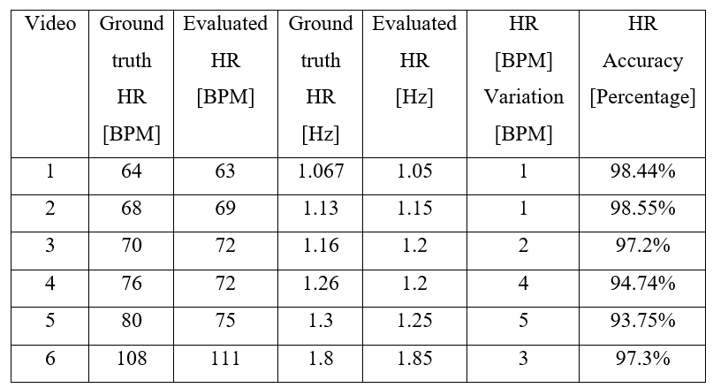
Results
Validated system accuracy against oximeter readings
Diverse participants, 20-30 years, 60-120 BPM range
Two-tier data approach for verification and performance
System showed 93% accuracy in natural lighting

Slide 14
Testing Process

Slide 15
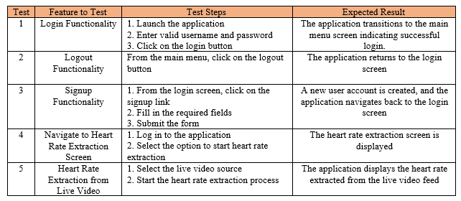
Acceptance Testing

Slide 16
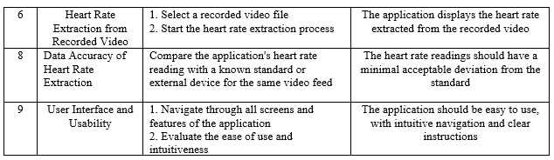
Acceptance Testing

Slide 17
Project Metrics

Slide 18
Project Metrics
Achieved proof of concept for heart rate extraction
Identified critical challenges with noisy data
Main goal met: Video-based heart rate monitoring is feasible
Future focus: Enhancing noise reduction
Accurate pulse estimation achieved
User-friendly interface achieved

Slide 19
Conclusion & Insights

Slide 20
Conclusion & Insights
Natural lighting improved result reliability
Noise reduction is crucial for real world lightning conditions
Heart rate extraction proof of concept achieved
Recommended continued project in the future

Slide 21

Project Demo

Slide 22
Thanks for listening, Any questions?

